Slide 1
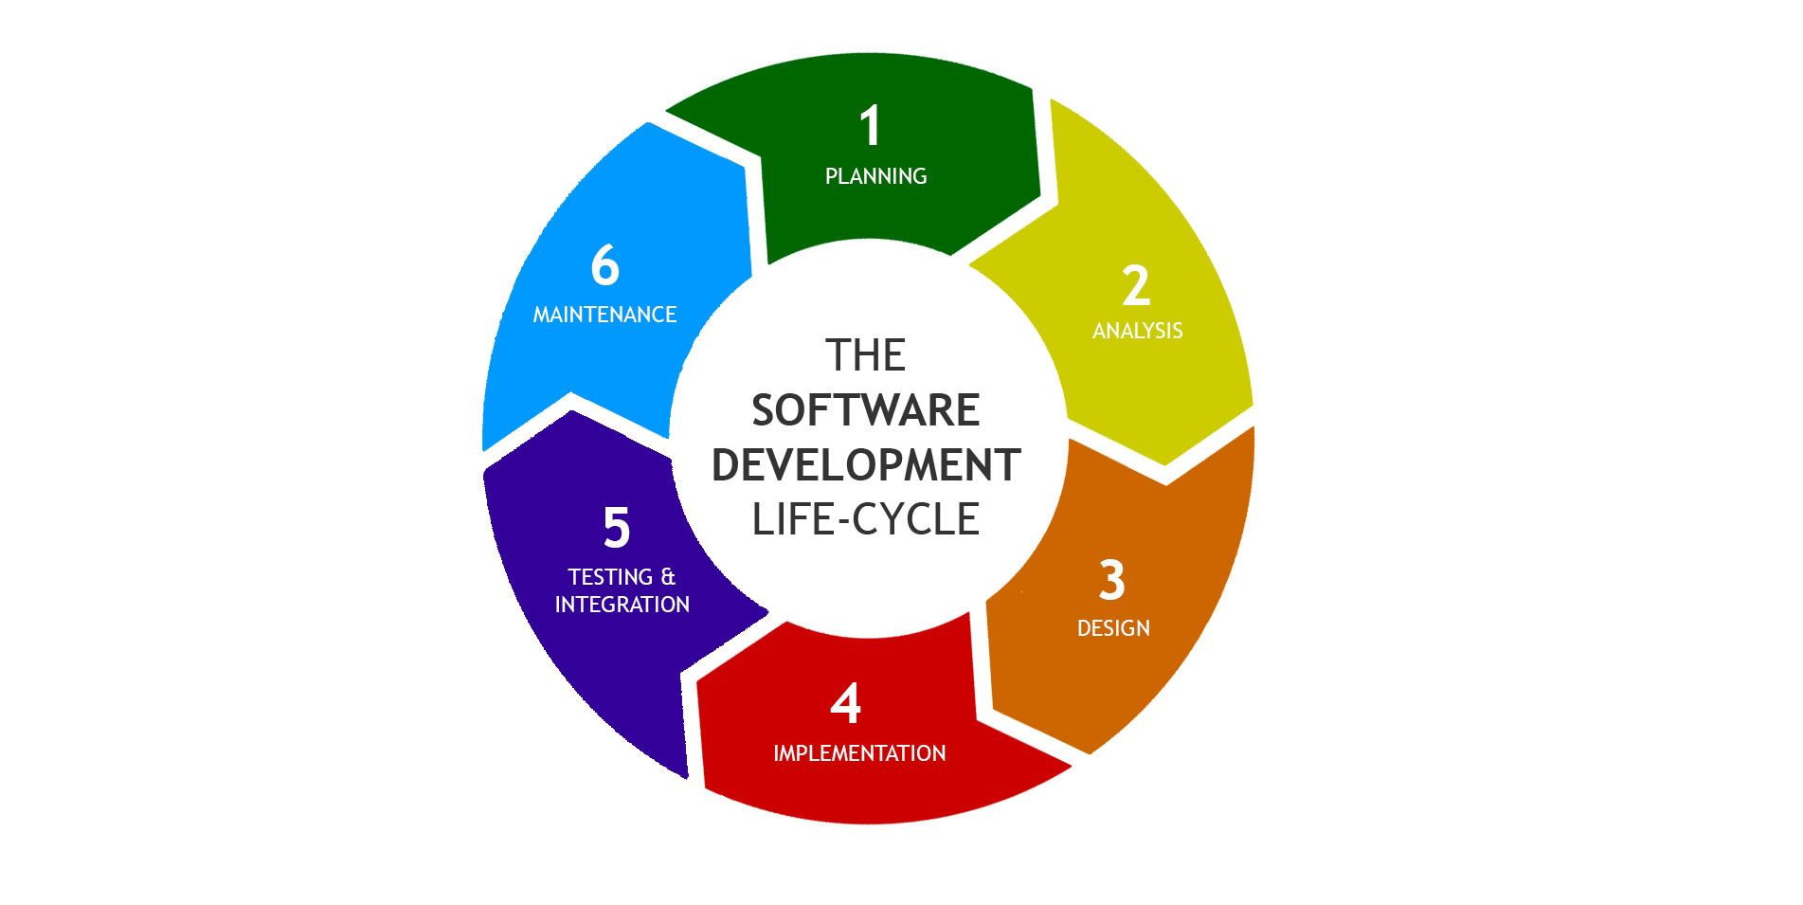
System Development Life Cycle
A journey. Not just the destination.

Slide 2
Overview
Software Development Life Cycle (SDLC):
A process used by the software industry to design, develop and test high quality softwares. It is a process used to develop information systems and user ownership.

Slide 3
SDLC includes the following phases:
Requirements
Design
Implementation
Testing
Deployment
Maintenance

Slide 4
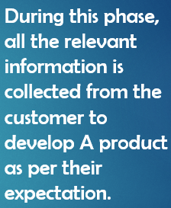
SDLC includes the following phases:
Requirements
Design
Implementation
Testing
Deployment
Maintenance

Slide 5
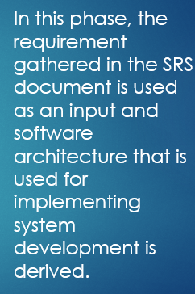
SDLC includes the following phases:
Requirements
Design
Implementation
Testing
Deployment
Maintenance

Slide 6
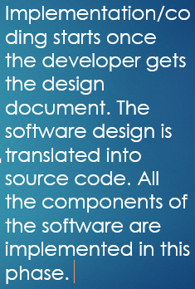
SDLC includes the following phases:
Requirements
Design
Implementation
Testing
Deployment
Maintenance

Slide 7
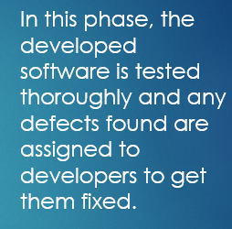
SDLC includes the following phases:
Requirements
Design
Implementation
Testing
Deployment
Maintenance

Slide 8
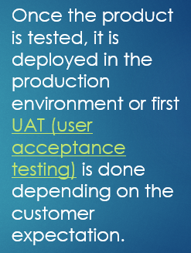
SDLC includes the following phases:
Requirements
Design
Implementation
Testing
Deployment
Maintenance

Slide 9
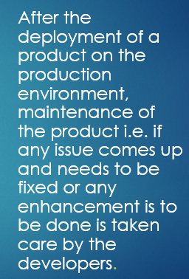
SDLC includes the following phases:
Requirements
Design
Implementation
Testing
Deployment
Maintenance

